Slide 1
Multi-Sensor Fire Alarm
Eleazar Arnold – P2765566
ENG3000
Supervisor - Krishna Nama Manjunathan

Slide 2
Introduction
A solar-powered multi-sensor indoor air monitoring device that alerts users in real time with a mobile app connected to an mqtt broker
Most homes use separate alarms (Heat, Smoke, CO), wasting energy and materials.
My system combines them all and runs on renewable energy, supporting health, sustainability, and safety.

Slide 3
Aims & Objectives
Objectives
Combining multiple environmental sensors in one system
Notify users via real-time mobile alerts
Everyone has a phone, so this will be practical
Reduce battery waste using solar + rechargeable LiPo
United Nations Goals Supported
Affordable and clean energy
Power the device with solar energy and rechargeable battery
Climate action
Reduce battery waste and greenhouse emissions
Good health and well-being
Notify users through a cross-platform mobile app (gives peace of mind as well)
Support indoor air quality and fire safety

Slide 4
System architecture
Sensors/Peripherals:
DHT
MQ7
BMP280
GP2Y1014
Esp32
Reads sensor data
Publishes to mqtt broker (HIVEMQ)
Runs on solar power
Arduino ide to program the esp32
Sensor peripherals
DHT11
BMP280
MQ-7
GP2Y101OAU
Power system
MT3608
TP4056
8 SOLAR CELLS FORM SUMIYA
LiPo BATTERY
App – Flutter
Decoding and creating widgets
Going into the source code
Communication
Firebase (FCM)
Mqtt functions
Json payloads
ESP32
MQTT Broker
(HIVEMQ)
Mobile App
Battery
Firebase Alert (FCM)
Solar Cells

Slide 5
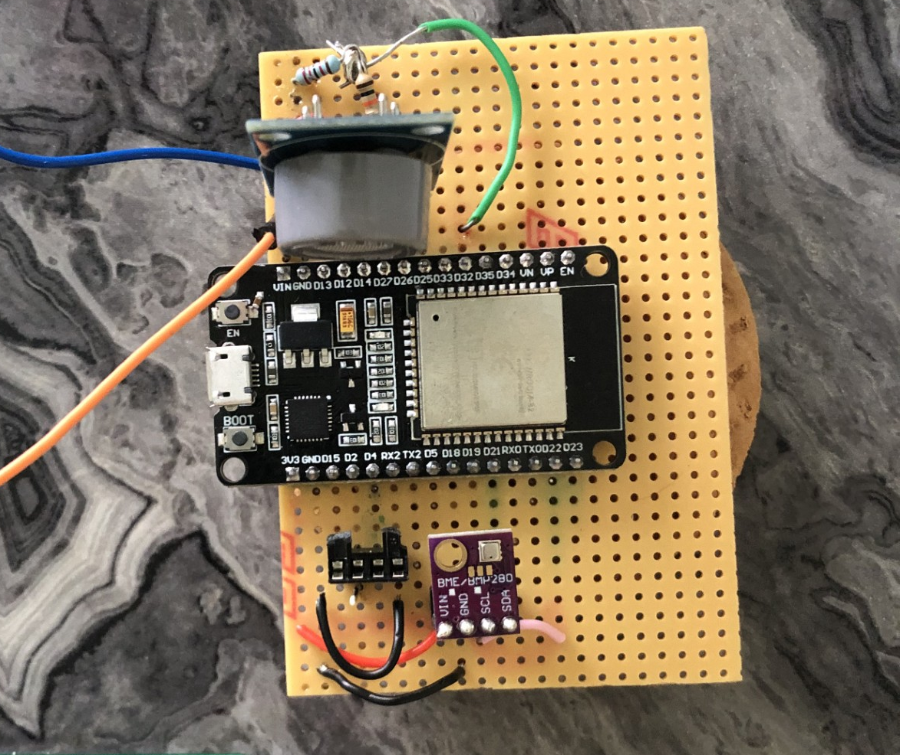
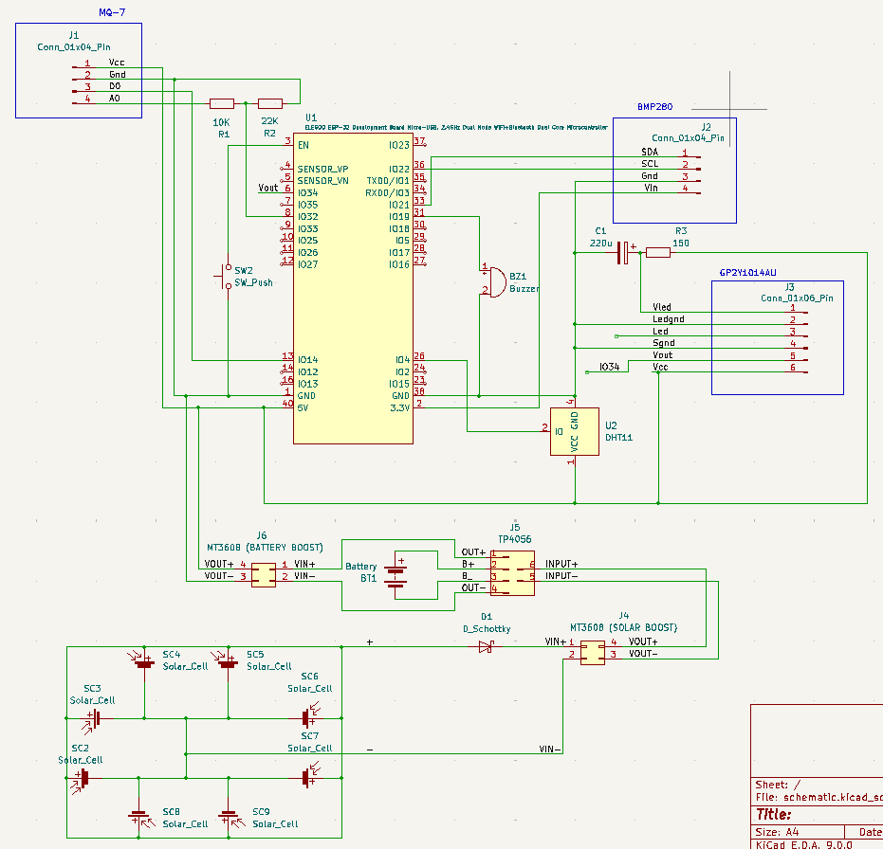
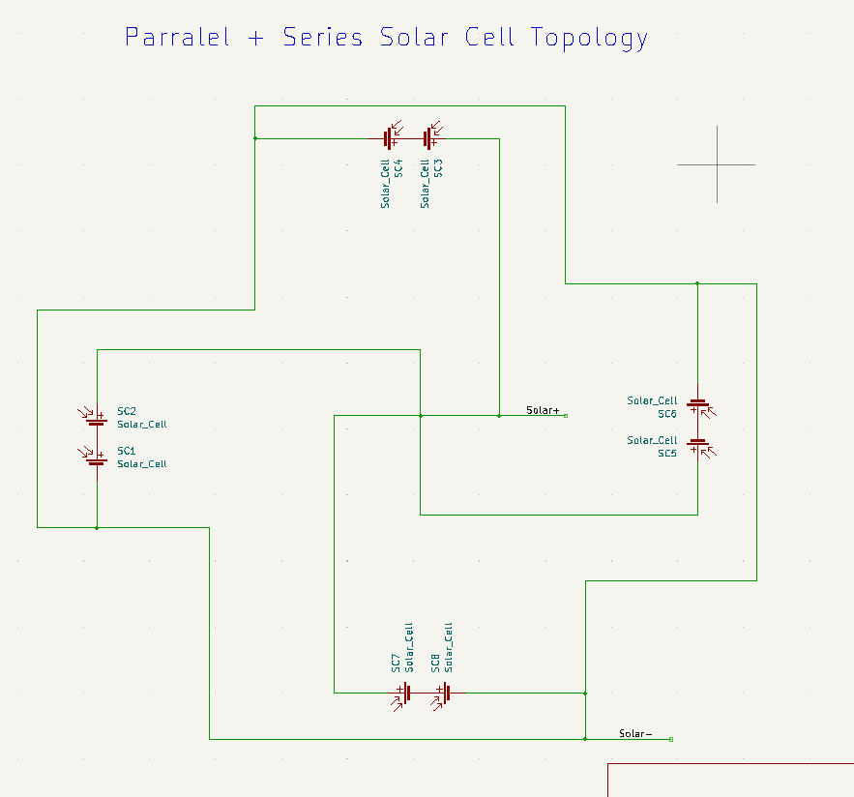
Hardware
ALL ON A STRIPBOARD FOR NOW
Designed on KICAD (PCB is ready for fabrication)
ESP32 – chosen for Wi-Fi, small, cheap, and reliable
Sensor peripherals
DHT11
BMP280 (connected through i2c)
MQ-7
GP2Y1010AU
Power system
MT3608
TP4056
8 SOLAR CELLS FORM SUNMIYA (changed topology from report submission) →
LiPo BATTERY

Slide 6
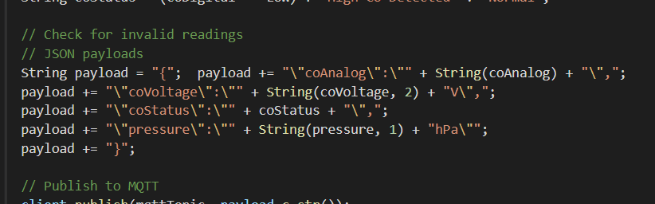
Software
ESP32
SENSOR READINGS ARE TURNED INTO JSON PAYLOADS MADE IN THE ESP32 PROGRAM(C++), ARE SENT TO THE HIVEMQ BROKER.
JSON (JavaScript Object Notation)
Google Firebase
App backend building service in my case, I will use it for cloud messaging
Used as a database, can also do things such graph data and analyse
HiveMQ
Private broker that holds payloads
During testing, the broker I used was test.mosquitto.org
Flutter (also made by Google in 2017)
Firebase messaging dependency(library) needs to be added
Going into the source code to enable push notifications: in-app and when the app is in the background
Mqtt functions are required in the dependencies/libraries
Local push notification library has to too
FLUTTER APP IS SUBSCRIBED TO THE BROKER AND DECODES THE JSON PAYLOAD AND DISPLAYS EACH INDIVIDUAL SENSOR READINGS ON THE WIDGETS
Decoding JSON payloads and creating widgets
WHEN A READING HAS BREACHED ITS THRESHOLD (EG: SMOKE = HIGH), THEN THE APP WILL SEND A HIGH-PRIORITY NOTIFICATION

Slide 7
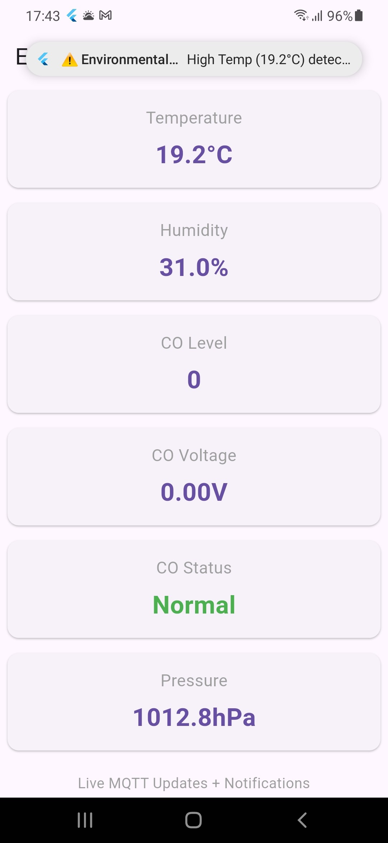
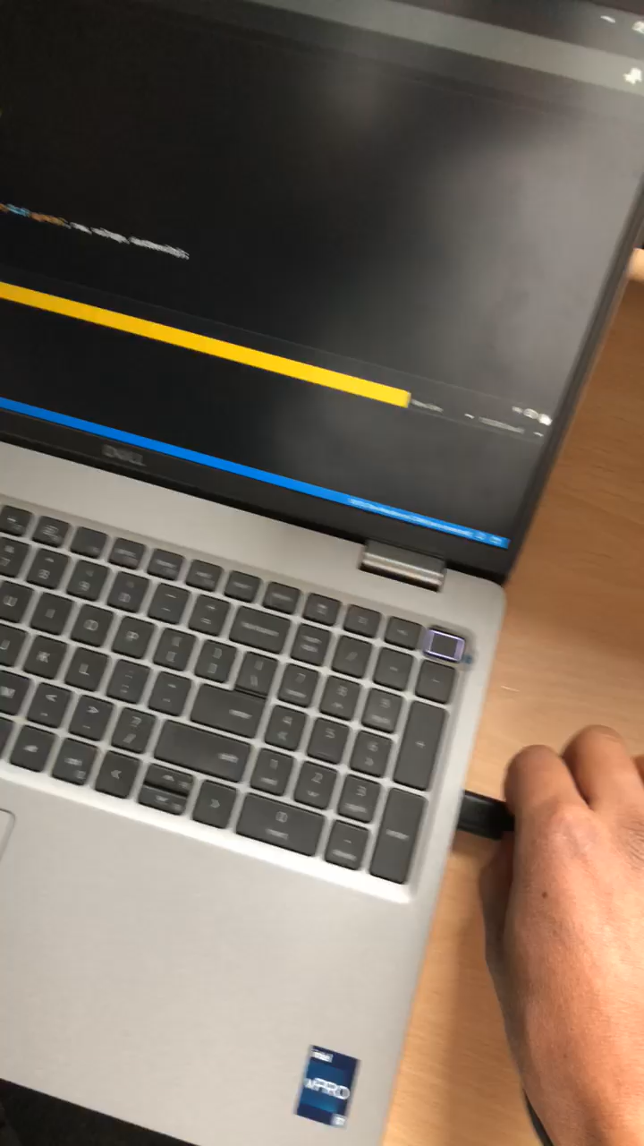
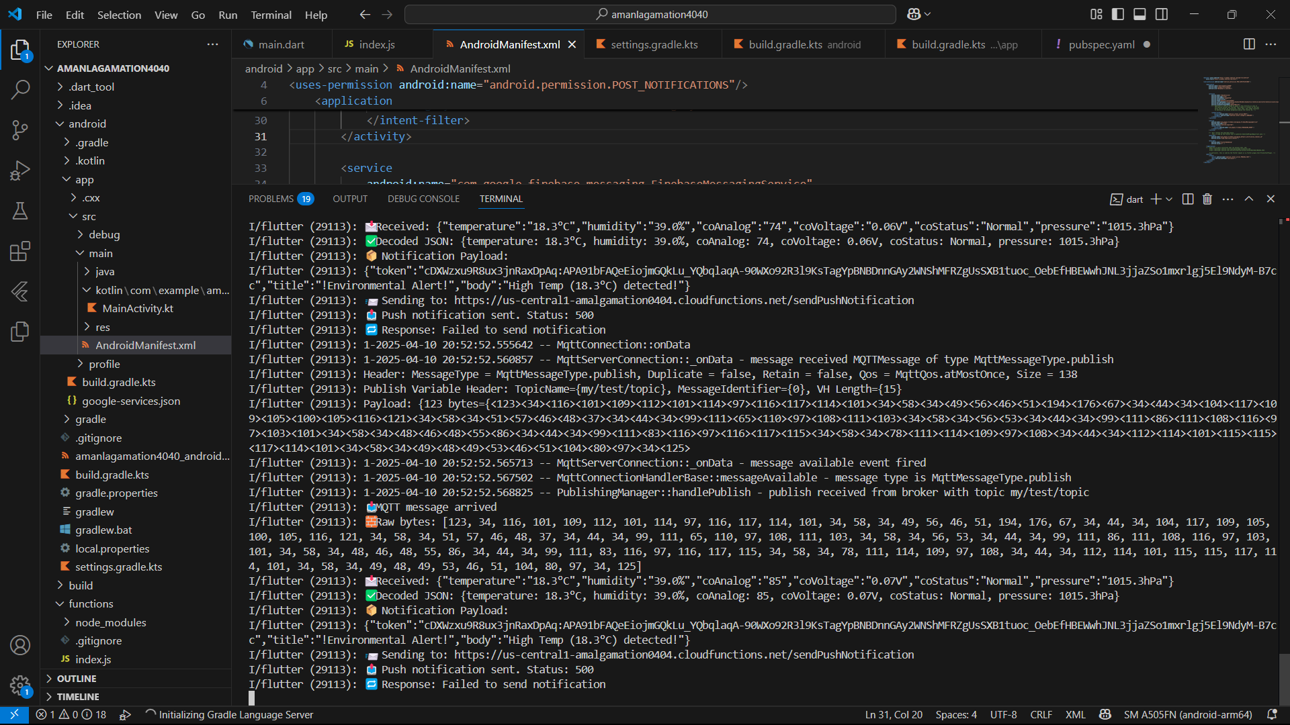
Demonstration
Show how it works (restart phone/app if you have to)

Slide 8
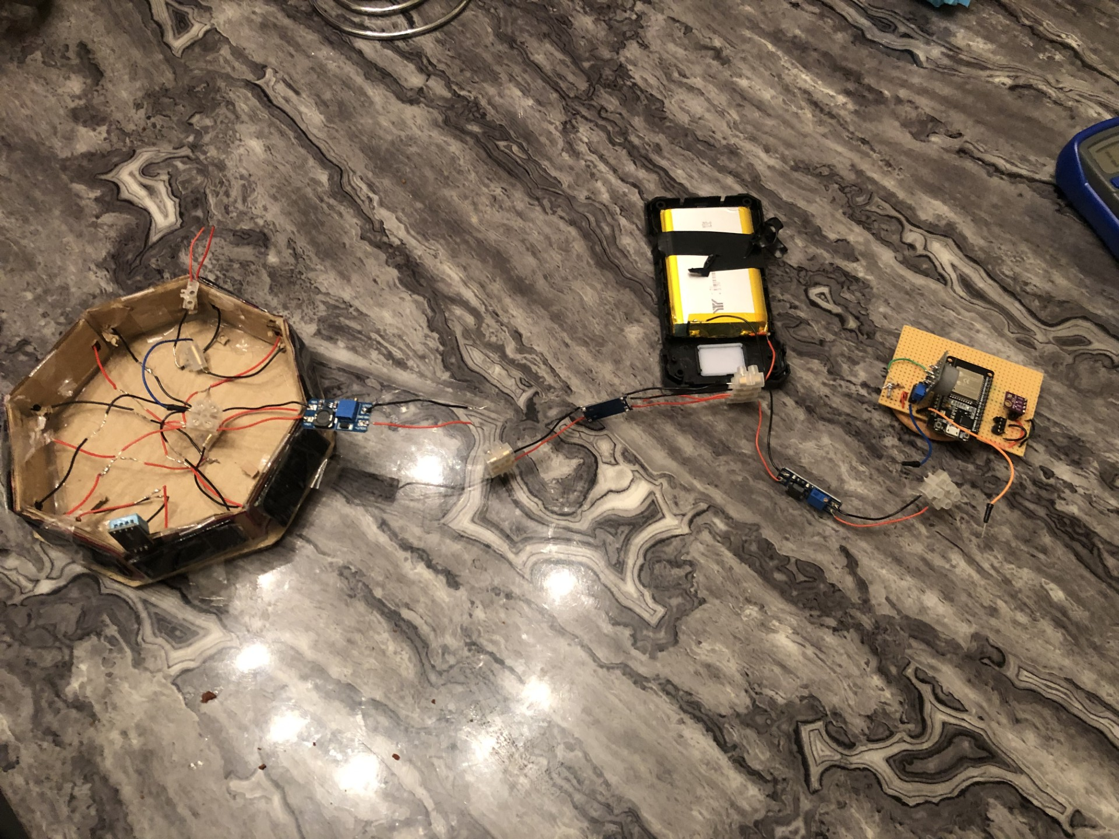
Testing and Results
Much troubleshooting, especially with software!
Costs were high!
1. Solar Cells + LiPo Battery and Modules
I measured output voltage by measuring the potential difference across the positive bus and negative bus of the solar cells, as they’re connected in parallel
In low light, the topology generates about 0.8 volts; in normal light, it's about 4 volts. In high light, it can go up to 6 volts.
(include voltage log screenshot or show in demo)
2. Sensor Behavior
DHT11: The values of temperature and humidity were consistent with the room
Ended up destroying the ESP32 voltage regulator and DHT11 module, due to MT3608 startup (power surge)
MQ-7: Responds to carbon monoxide levels in the air and also reacts to nearby combustion
BMP280: It has Stable pressure values and is very consistent.
GP2Y1014: Previously worked independently but has not been integrated into the system peripherals
Optical smoke sensor kept on failing
3. Full System
Data correctly sent via MQTT to the App
JSON formatted and was sent correctly with no issues
Push notifications were triggered successfully

Slide 9
Evaluation and Conclusion
Positives:
Real-time notifications
Runs on solar (renewable) energy
Cross-platform mobile app (Flutter)
Easy to upgrade, such as reprogramming esp32 or adding more peripherals
Negatives:
GP2Y1010AU0F failed during testing
Cloud-dependent (no offline alerts) and no notifications when app is terminated and not running in the background
No enclosure, so the components are exposed at the moment
Linked to the point above, the PCB wasn't fabricated in time (used stripboard instead)
Deep sleep mode wasn’t implemented. It could have been a GPIO pin acting as a voltmeter to the TP4056 battery terminal. When it reaches below a certain threshold, it activates sleep mode. That is only measuring smoke, heat and carbon monoxide,
I haven’t coded it for iOS, and at the moment, the app is privately downloaded from my PC. It is also not natively coded for Android.
Also, the device isn’t completed, such as he real PCB or the real body
Conclusion:
The system meets original aims:
low-cost, multi-sensor, solar-powered, mobile-integrated
Successfully implemented real-time monitoring and push notifications
Enabling notifications was the trickiest part.
Future Work:
Build final chassis (possibly from heat resistant material)
Finish PCB and solder all components
Add a local alert system (buzzer and reset button)
Reduce the cost of components
Add a different smoke sensor (as GP2Y1010AU0F kept on failing)

